Slide 1
Activity 1
Transition activity
Booklet = your ideas and opinions
Draw
Write
Speak
Activity 1
Have you done any transition activities recently?
Notes:
The first activity is just to check on your status with regard to school transition. Has anyone done any activities that are designed to help you change schools or change year levels? For example, do you know where you will go for secondary school? Have you been to any tours or information nights? Do you have to do any tests/auditions/interviews to get in to the school or for placement? Have you talked to anyone – friends, family – about going to secondary school?)

Slide 2
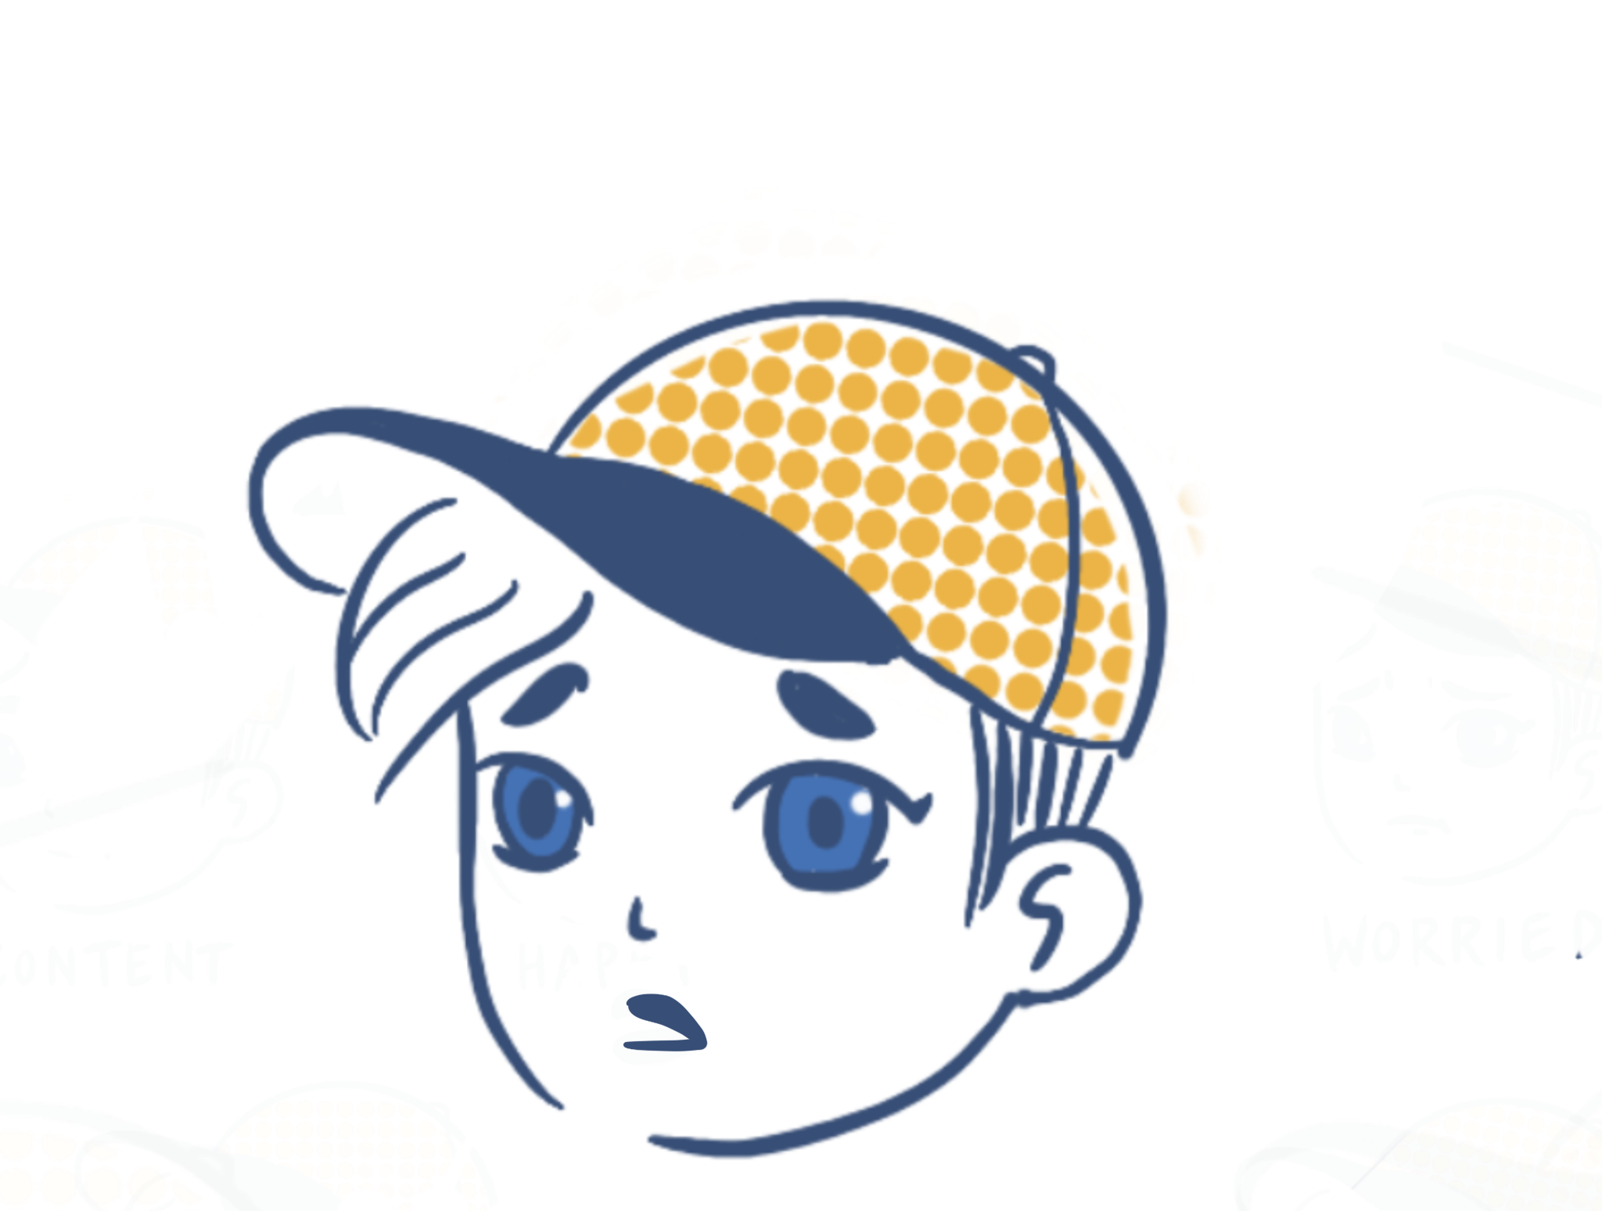
How do you feel?
Activity 2
Choose one or more characters that represents how you feel about your school transition.
Briefly label your chosen character/s. What makes you feel that way?
Notes:
We would like you to think about the idea of school transition. That is, what does transition mean for you (is it moving school, moving within a school?). Then, try to connect with your feelings about school transition.
We’d like you to choose one or more emoji that show your feelings about your school transition. The emoji on the slide are just examples, feel free to draw a different one. Please label your emoji so that it’s clear which emotion it is. [If needed, brief discussion on how emoji can be interpreted different ways]

Slide 3
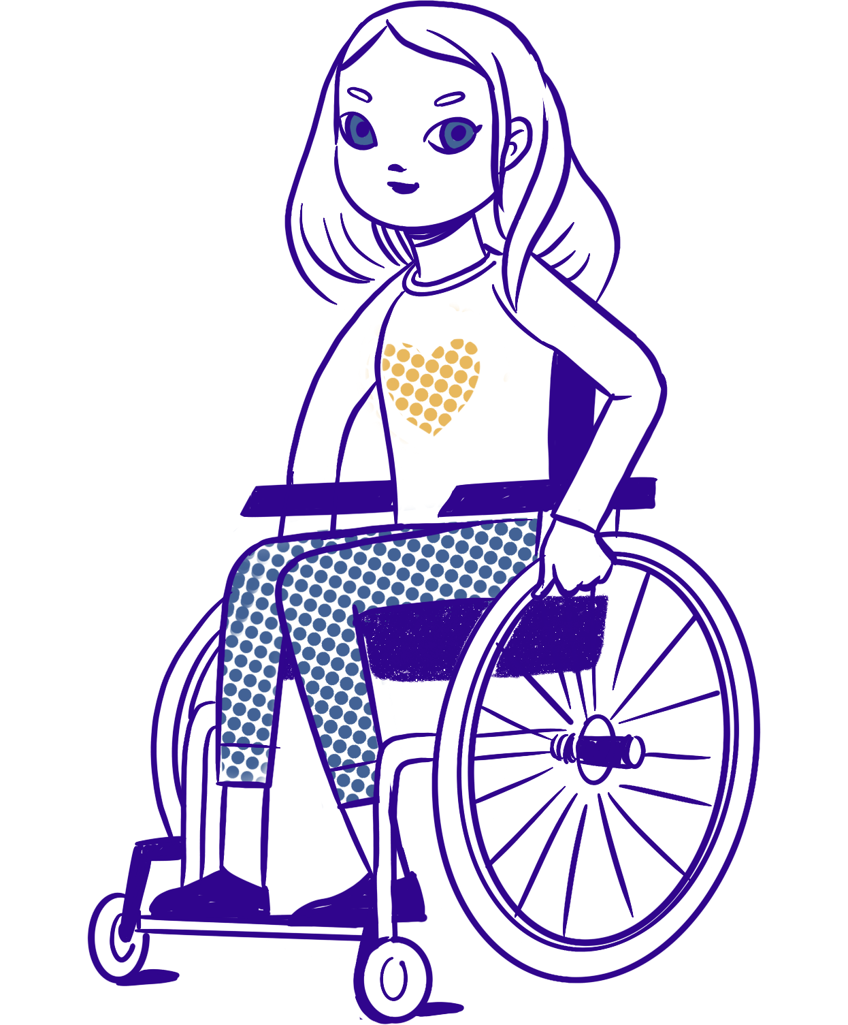
Activity 2 cont’d…
I’m excited and nervous about the next steps.
What other things impact school transition?
What else is going on in your world?
Draw/label these around an emoji of yourself.
Notes:
Now that you’ve had a chance to draw and label how you feel about your own school transition, we’d like you to have a think about other things that may impact your feelings. That is, what else happens in your life that might affect how you feel about school changes? For example, is there anything related to your family, friends, sports or other activities that influence how you feel?
We’d like you to label these other influences around your emoji. You can illustrate them if you wish.
There is an example on the next slide.
[Prompts: Tell us more about ... What would that look/feel/sound like? general encouragement strategies]

Slide 4
How do you feel?
Activity 2 cont’d…
Examples:
I worry I won’t shine in a new environment.
Is my new school like a different planet?
I don’t know if I’m going to fit in, but
I think I’ll be fine.
Notes:
There are a few ‘crazy’ examples on this slide to show you what pictures and labels might look like. You don’t have to draw detailed pictures if you don’t want to – stick figures are fine. What is it that influences your feelings about school transition?
[Have a good look at these examples, then go back to slide 7 while students complete the activity]

Slide 5
Activity 2 continued…
Share your thoughts
What are the positives?
What are the negatives?
Add to your own ideas if you wish
Notes:
[This is a partner or small-group exercise – teachers to decide as appropriate for their class. Emphasise that students don’t need to share anything they are uncomfortable with.]
Now that you’ve had a chance to think through your feelings about school transition, and think about some of the things that influence your transition, we will discuss some of the ideas that have come up.
As we talk about everyone’s ideas, please feel free to add to your own drawings or labels if more things come to mind or if any further ideas apply to you too.
[Time for discussion. The next activity will focus the ideas further.]

Slide 6
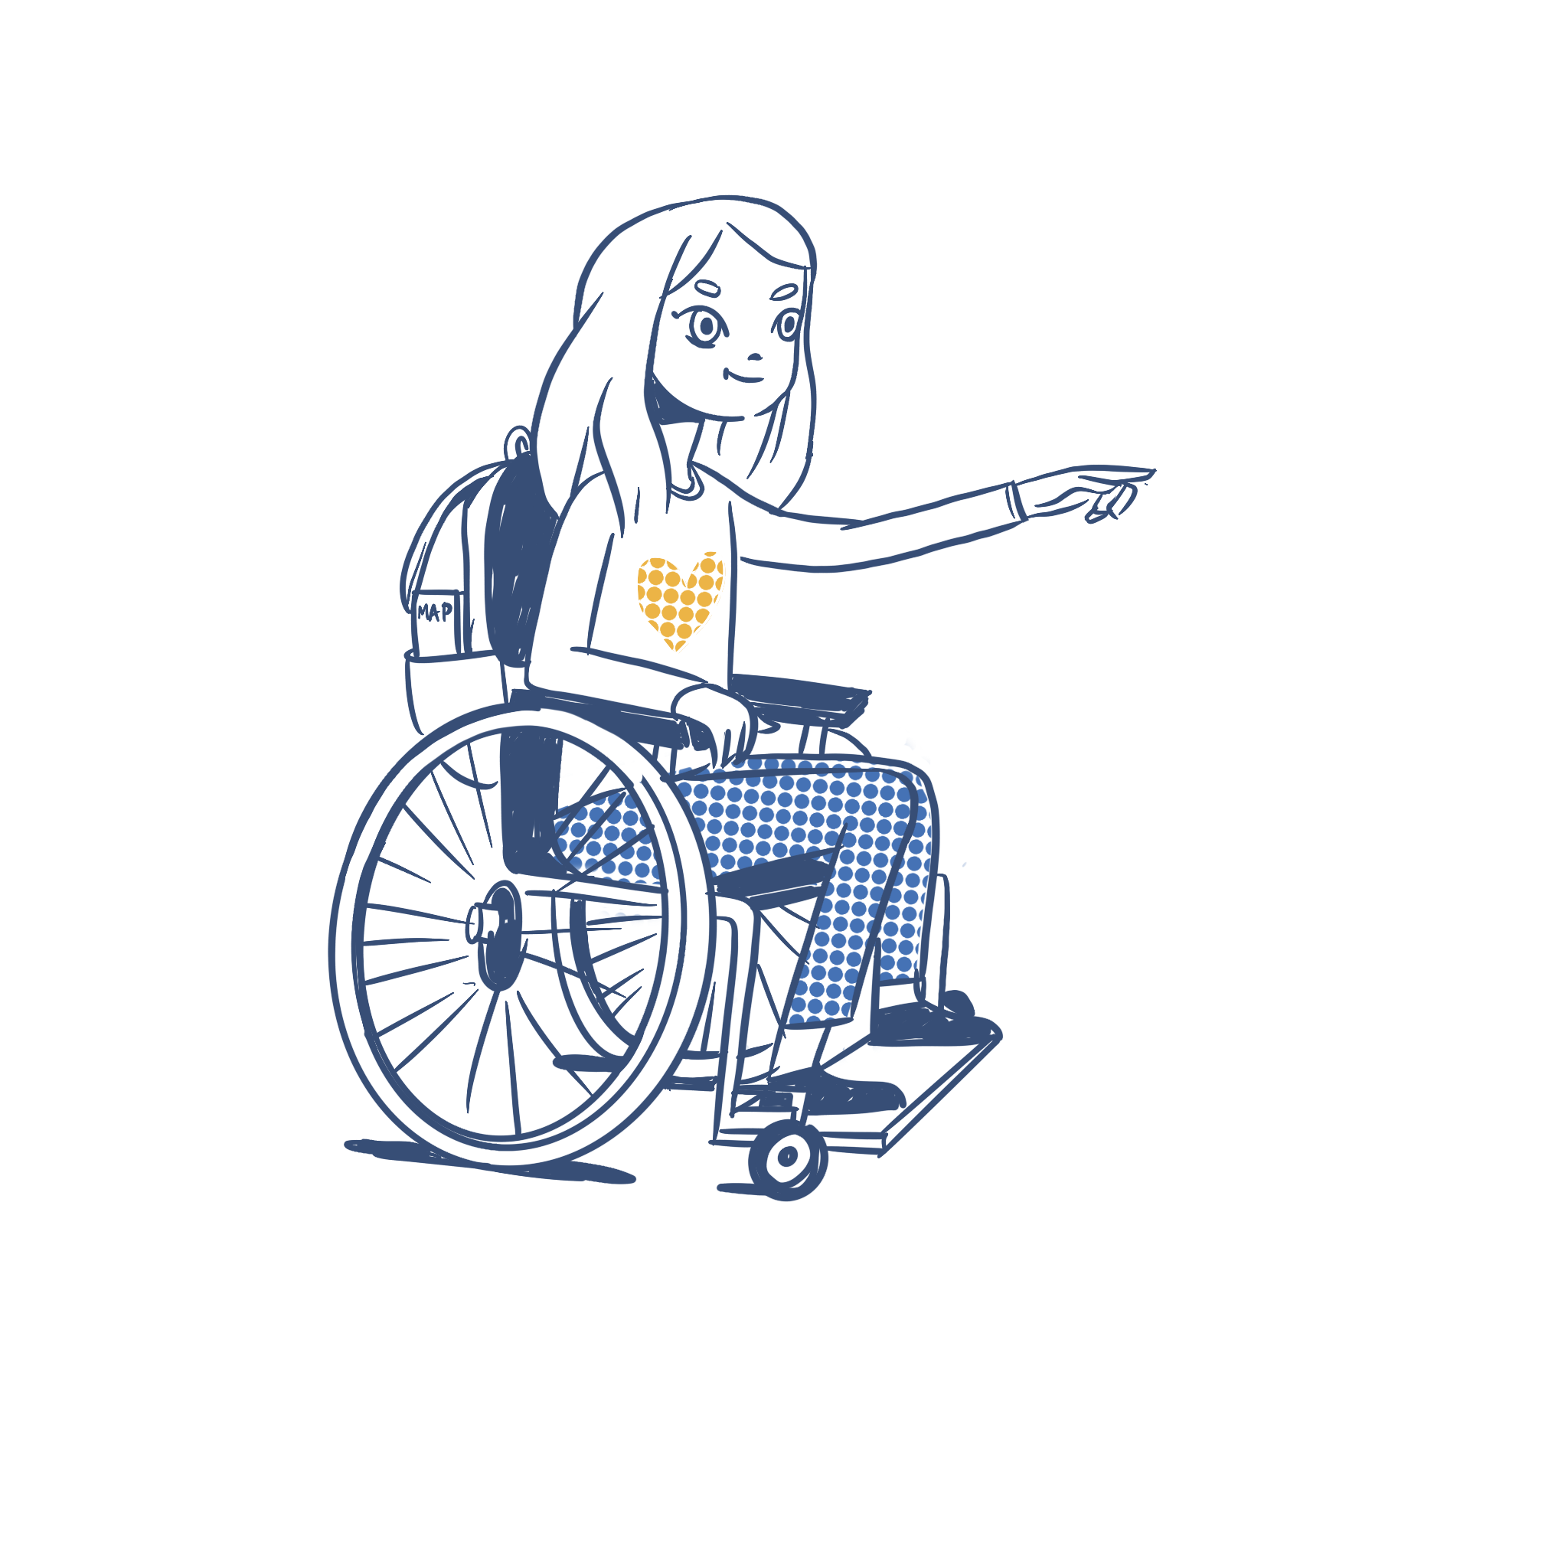
Ways forward
Activity 3
Pick one or two of the characters you’ve used.
What worries or challenges you the most?
Would anything solve this? What would help make it easier?
What would be needed to do this?
Do you need people, things, time, activities, money, etc.?
Notes:
[This is a partner or small-group exercise – teachers to decide as appropriate for their class. Emphasise that students don’t need to share anything they are uncomfortable with.]
Now that you’ve had a chance to think through your feelings about school transition, and think about some of the things that influence your transition, we will discuss some of the ideas that have come up.
As we talk about everyone’s ideas, please feel free to add to your own drawings or labels if more things come to mind or if any further ideas apply to you too.
[Time for discussion. The next activity will focus the ideas further.]

Slide 7
Anything else?
Activity 4
Survey – are others’ ideas also true for you?
How do you like to learn new things?
Do others also need to know about school transition?
Notes:
[Activity 4 is on the next page.]
This activity asks about five transition topics – these have been identified in academic research as things that are important to students, however, this activity is a check to see if they are also true for students in your class. Are these topics important for them?
Once students have considered the topics they’d like to talk about, they are prompted to think about how they could learn about them. For example, pen and paper-style study, listening to someone, talking to someone, YouTube, creating things (analogue or digital), individual research, group activities, etc.
The final question for Activity 4 asks students to consider whether anyone else in their community needs to know about their school transition. For example, do they need to teach their parents/caregivers about the challenge of moving school in the 2020s and beyond?

Slide 8
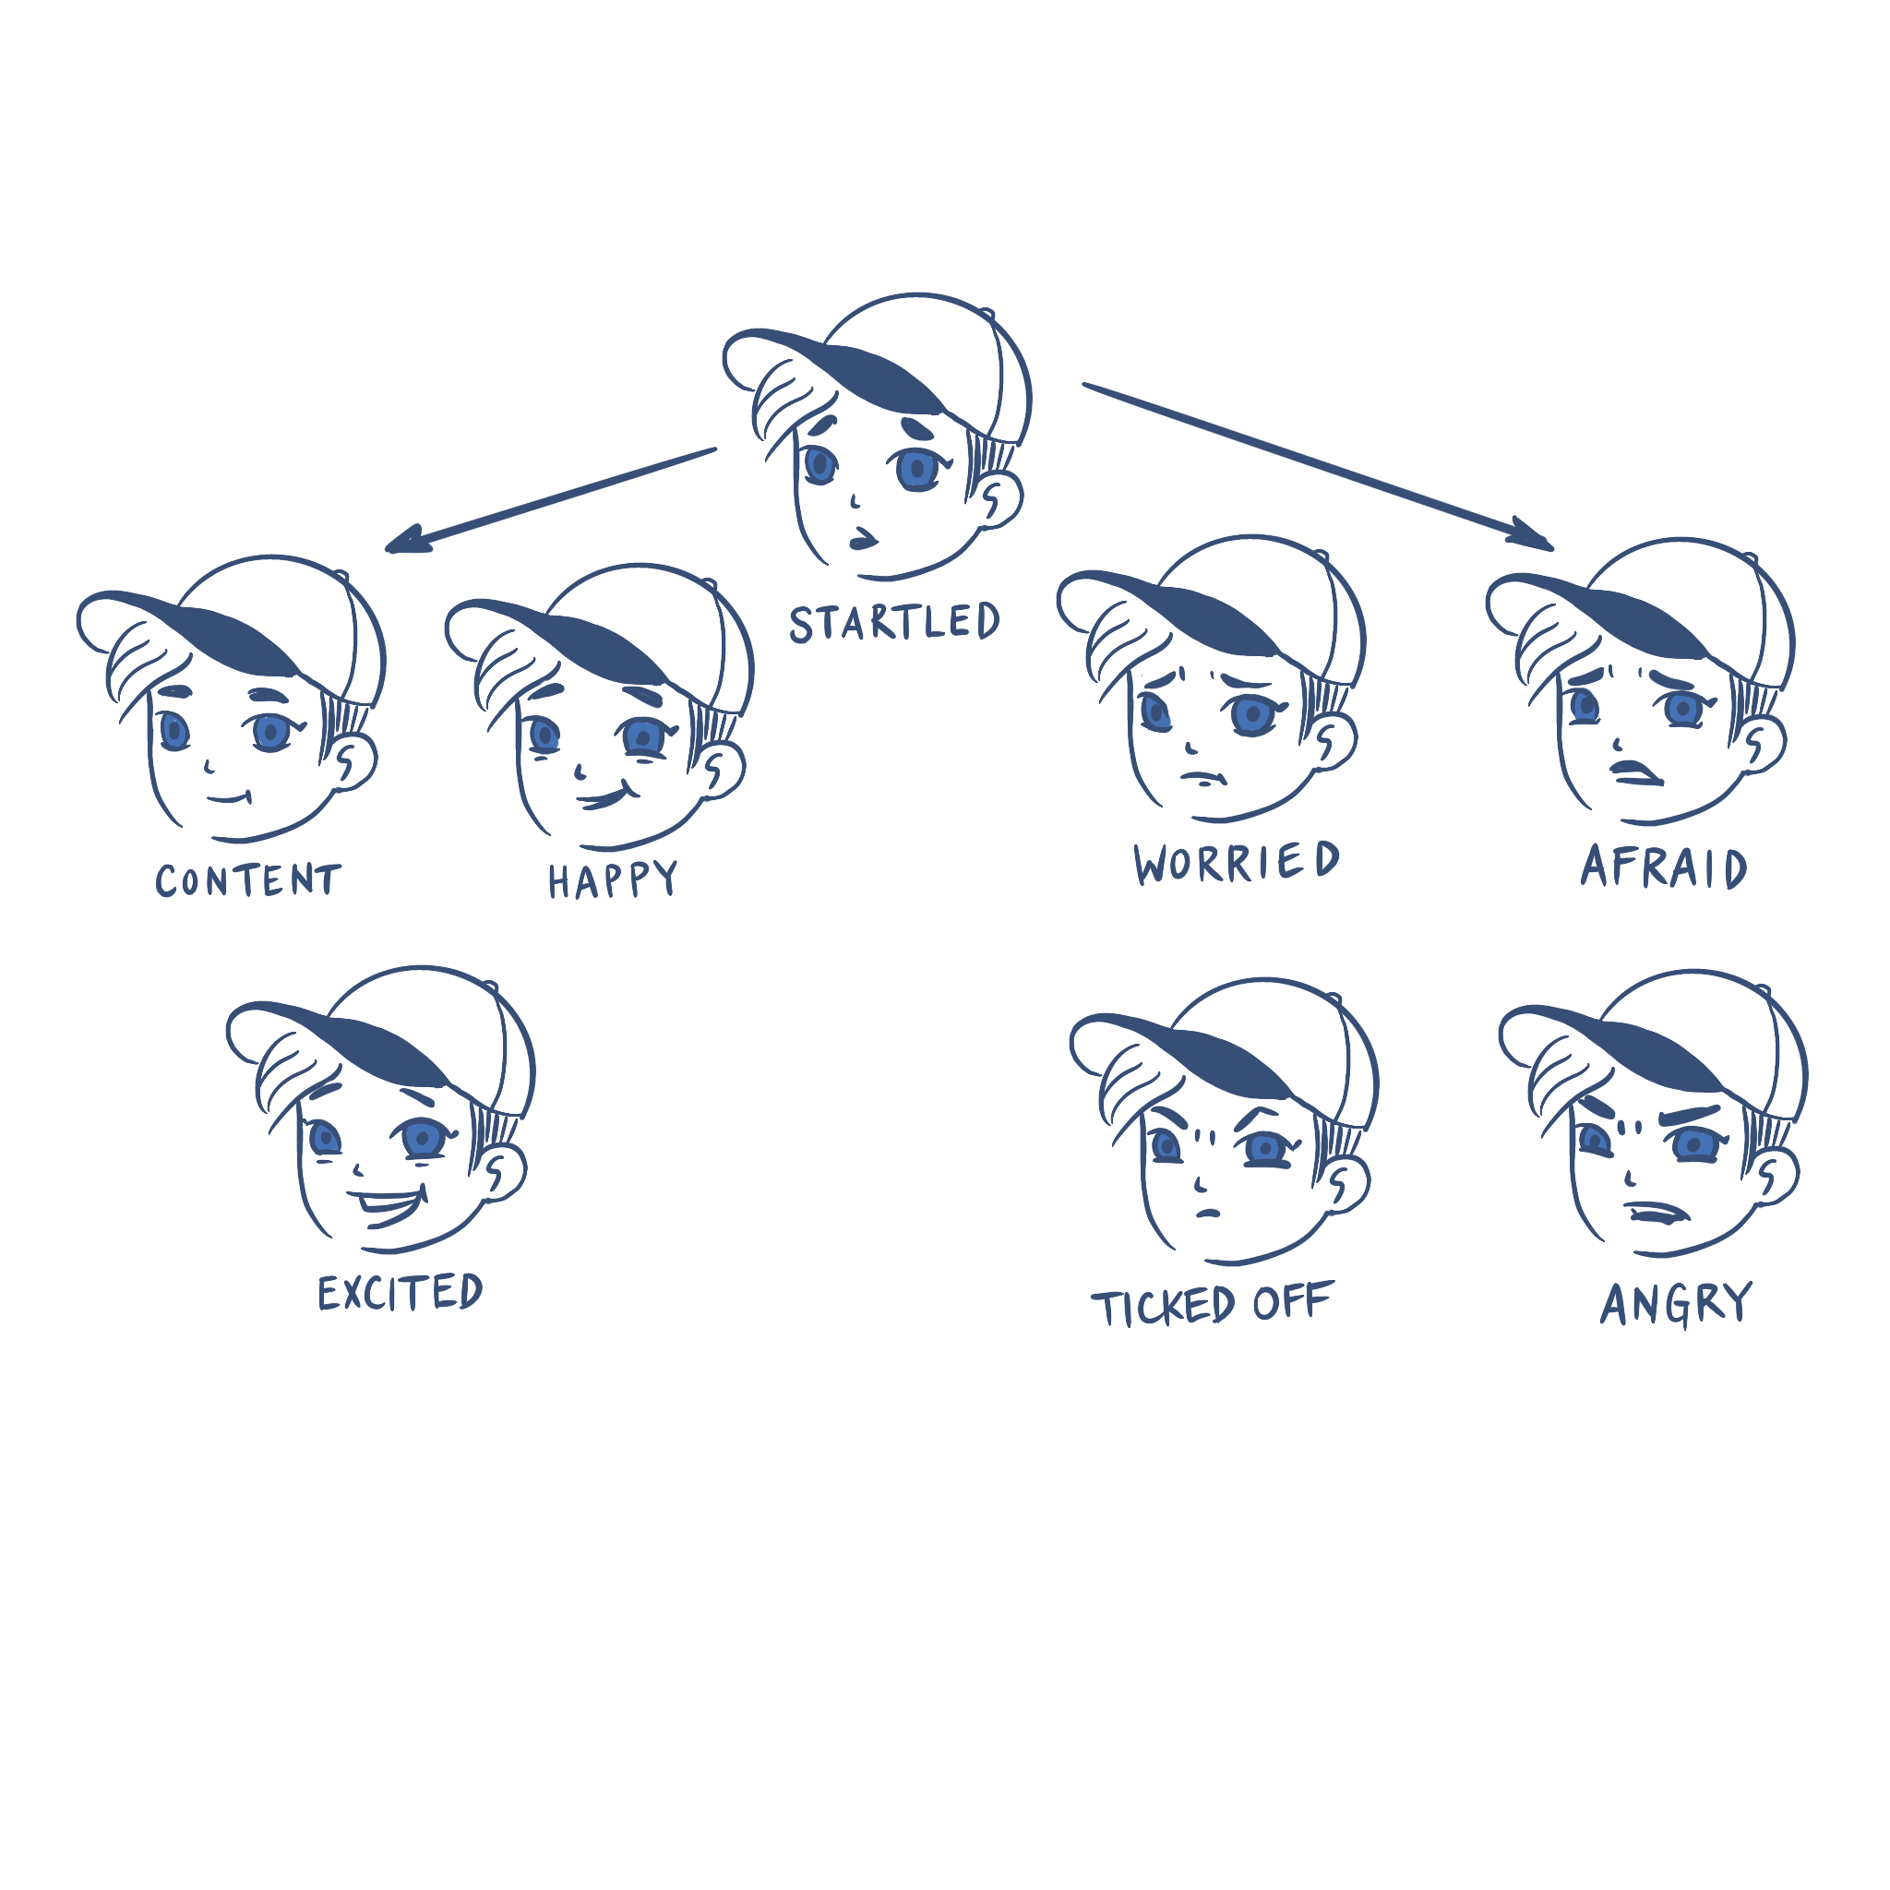
Activity 4 cont’d…
Colour or indicate the character that now describe where your headspace is with school transition.
And…
you’re finished!
Notes:
Teacher notes:
Remind the students that this has been a diagnostic activity. That is, it aims to collect information on where students are in this present moment, so that future classroom activities can be tailored to what they need.
Some students may be feeling uncomfortable, worried or overwhelmed about their school transition. It is very important that this is captured – through the booklet, through overhearing peer discussions, or through teacher observation – so that the teacher and school can be made aware of any student difficulties, and can act on strategies to help (what is standard protocol for referring mental health concerns in your school – teacher, counsellor, etc.?) The activity on the back page is designed to help capture this. When collecting the booklets, have a quick look at the back page to see if any students need immediate help.
Once you have collected the booklets from your students, see if you can identify any patterns in students’ responses. Is there anything that stands out as a common concern? Often, these can be used as future lesson topics for the whole class. Then, how will students be enabled to address their own individual concerns?

